Slide 1
What wine should you buy for your next date?
Alec Prostok, Dan Bruen, James Zheng

Slide 2
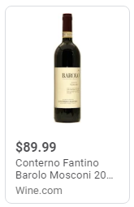
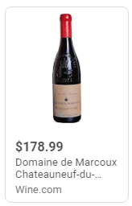
How would you choose?
Wine 1
Wine 2
94 Points
95 Points

Slide 3
Agenda
Intro
Project goal & key questions
Summary of Data - Dan
Points by Country & Price by Country
Data cleansing - Alec
How to we get to the final 6 countries
Analysis steps: - James
Is there a change in price per point?
Regression on the data
Is there a difference by country
Regression by top 6 countries

Slide 4
Description of our data:
Set up accounts on data.world.com
Found a large excel file that described “wine points and prices across the world by vintage, vineyard and variety.”
The excel file contained:
Bottle of wine by vintage (year produced), vineyard, quality and ‘variety’
Over 23,000 unique bottles of wine
42 vintages spanning from 1821 to 2016
37 different countries
We then converted the excel file to a csv and began our data analysis

Slide 5
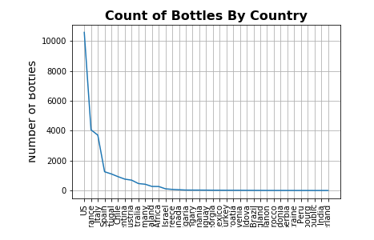
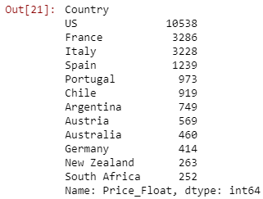
Breakdown by Country part 1
The US, France, Italy, Spain, Portugal and Chile produced the largest number of unique bottles of wine within our data set.

Slide 6
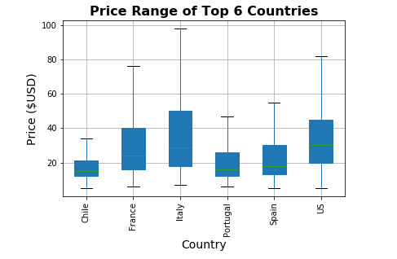
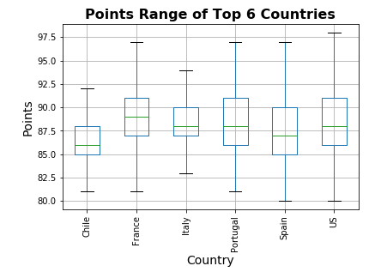
Breakdown by Country part 2

Slide 7
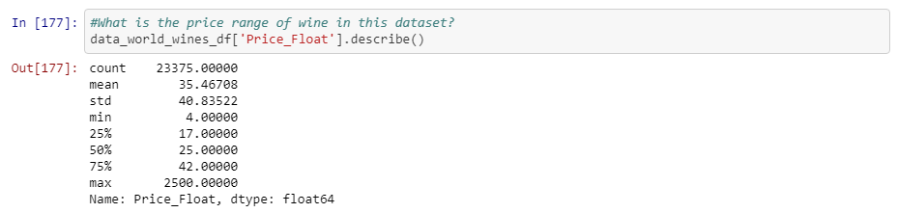
Description of Price Data

Slide 8
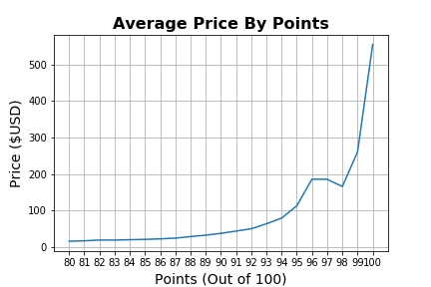
Is there a relationship between price and points?

Slide 9
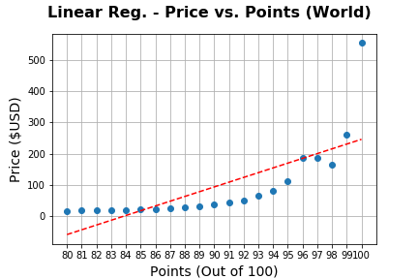
As our country breakdown shows, there is clearly a positive, linear relationship between price and points
p-value = 0.0001035
Since p-value <0.05, the linear regression is statistically significant.

Slide 10
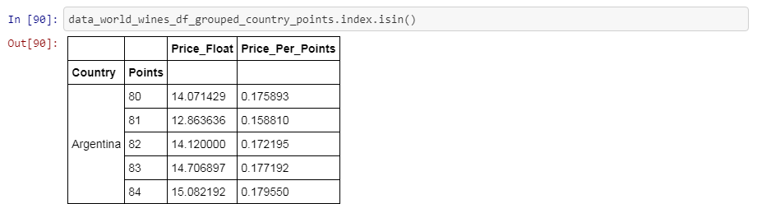
We then went on to calculate which countries provide the best ‘value’?
We created ‘price_per_points’ table i.e. what you you spend to earn one point of ‘quality’ to your wine
There are only 187 bottles of wine rated 96-points or higher

Slide 11
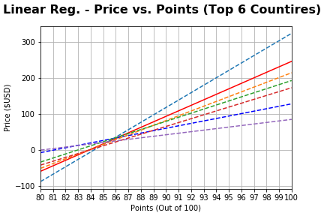
Regression Slide - with & without labels
What can we learn from the regression and can we derive value by country?

Slide 12
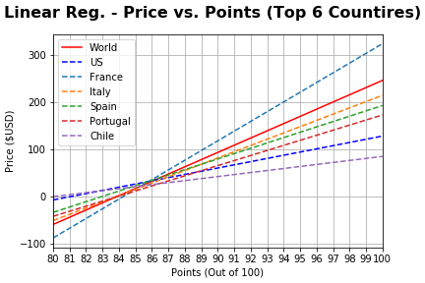
Regression Slide - with & without labels
What can we learn from the regression and can we derive value by country?

Slide 13
How would you choose?
Chile offers the best ‘value’ i.e. you spend the least amount of money to earn a point of quality on your wine
Wine, as a luxury item, can oftentimes be more art than science, and we believe our dataset illustrates the psychology behind buying wine – people are willing to pay a premium for ‘brand’ regions like Bordeaux
If you don’t believe us, watch the documentary ‘Sour Grapes’

Slide 14
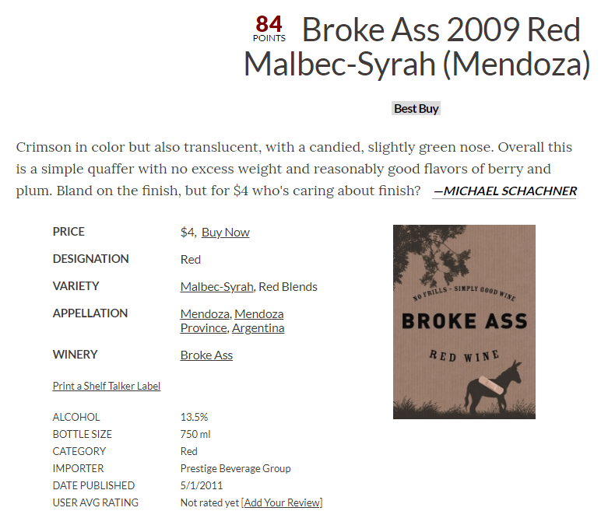
Final summary

